Slide 1


Module 3 Recommendations for Restaurants Serving Fast Food
Group 2
Fengxia Dong, Zhiyu Ji, Xinyue Wang

Slide 2
Contents
Introduction and Motivation
Data Cleaning and Pre-Processing
Exploratory Data Analysis
Key Findings About Restaurants Serving Fast Foods
Recommendations for Restaurants Serving Fast Foods
Shiny App Demonstration

Slide 3
Introduction and Motivation
Our analysis focuses on restaurants that provide fast food to customers.
Their average stars were only 2.69 on Yelp during the period of 10/2004 to 12/2019.
This category of restaurants has not been serving customers well.
They need advises to improve.

Slide 4
Data Cleaning and Pre-Processing
Select businesses in business json file with “fast food” listed in its category.
Select reviews for the chosen businesses from review json file.
Select related users and tips from user json file and tip json file, respectively.
33,262 reviews by 21,741 users for 1,638 restaurants serving fast food with 5,823 tips.

Slide 5
Data Cleaning and Pre-Processing
Utilize the R package “tidy2vec” to break the text into individual tokens and transform the list of tokens into a vector space.
Prune words occurring less than 10 times and those appearing in less than 0.1% of reviews.
Create a document-term matrix (DTM) for our further analysis.
In total, we have 15,163 words in the DTM.

Slide 6
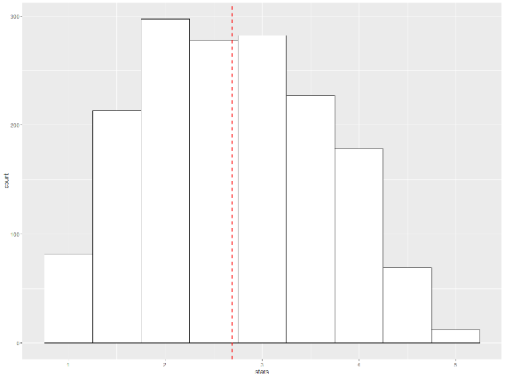
Exploratory Data Analysis
Selected restaurants are located in the states of Illinois, Ohio, Wisconsin, and Pennsylvania, with average stars ranging from 2.64 to 2.82.
Mean of stars is 2.69 with standard deviation of 0.94.

Slide 7
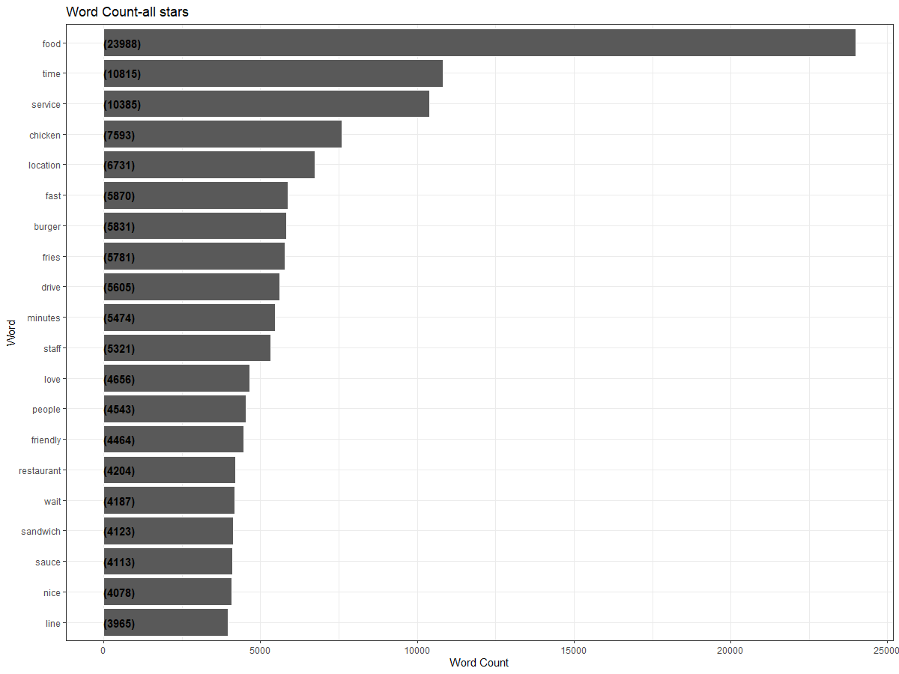
Exploratory Data Analysis
Examine the frequency of words appearing in reviews by using “tidytext” package in R.
Words that are not useful for an analysis are excluded.

Slide 8
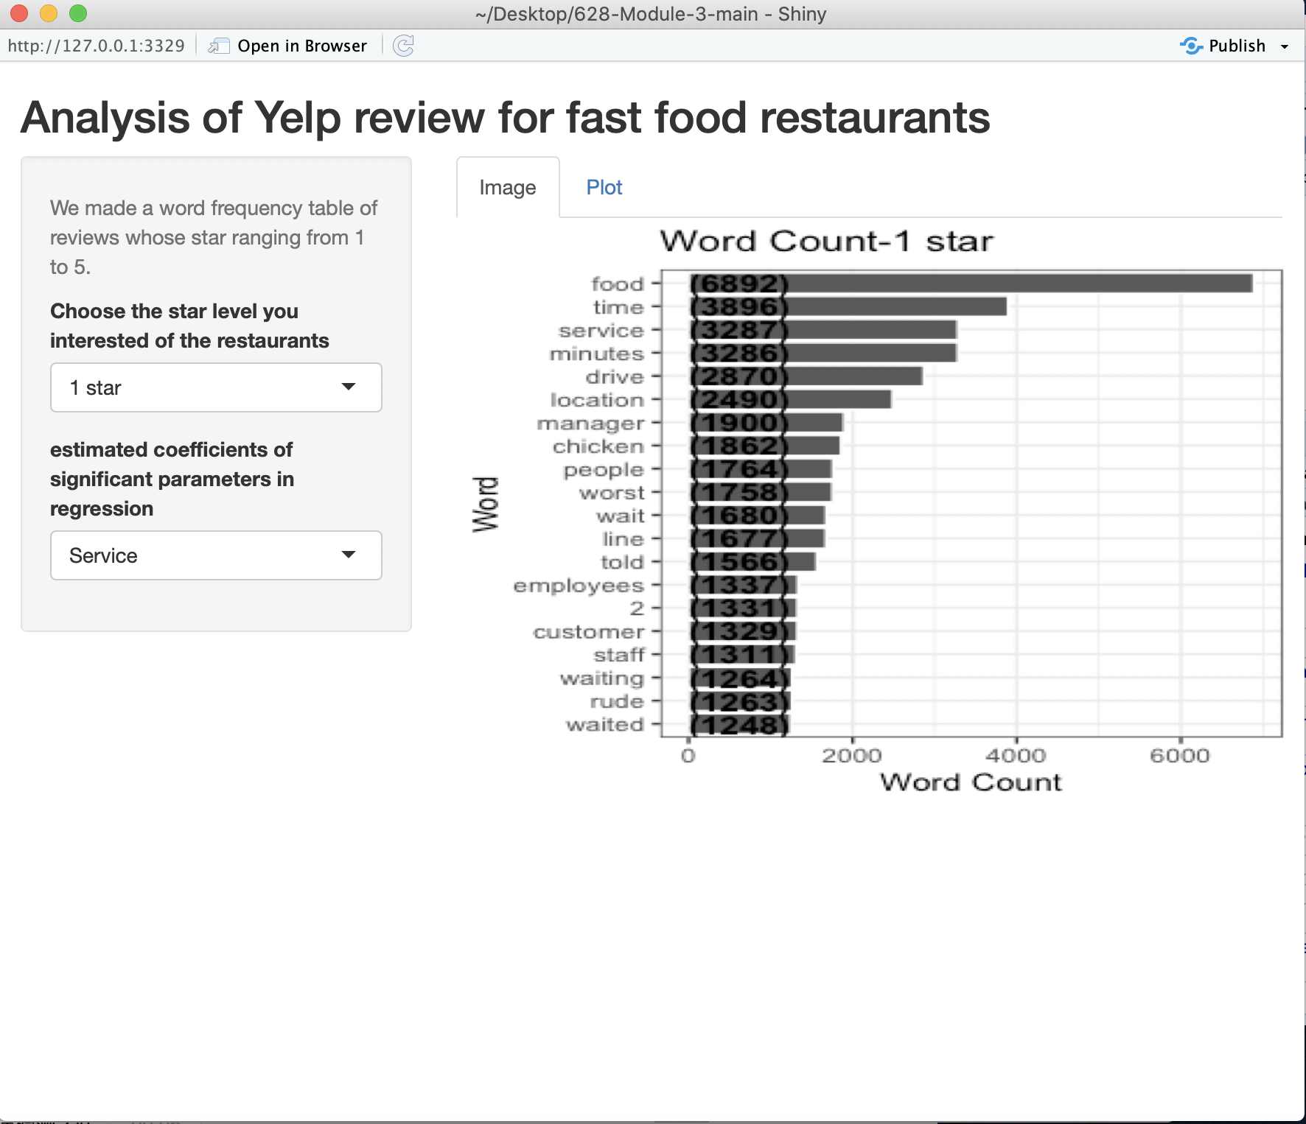
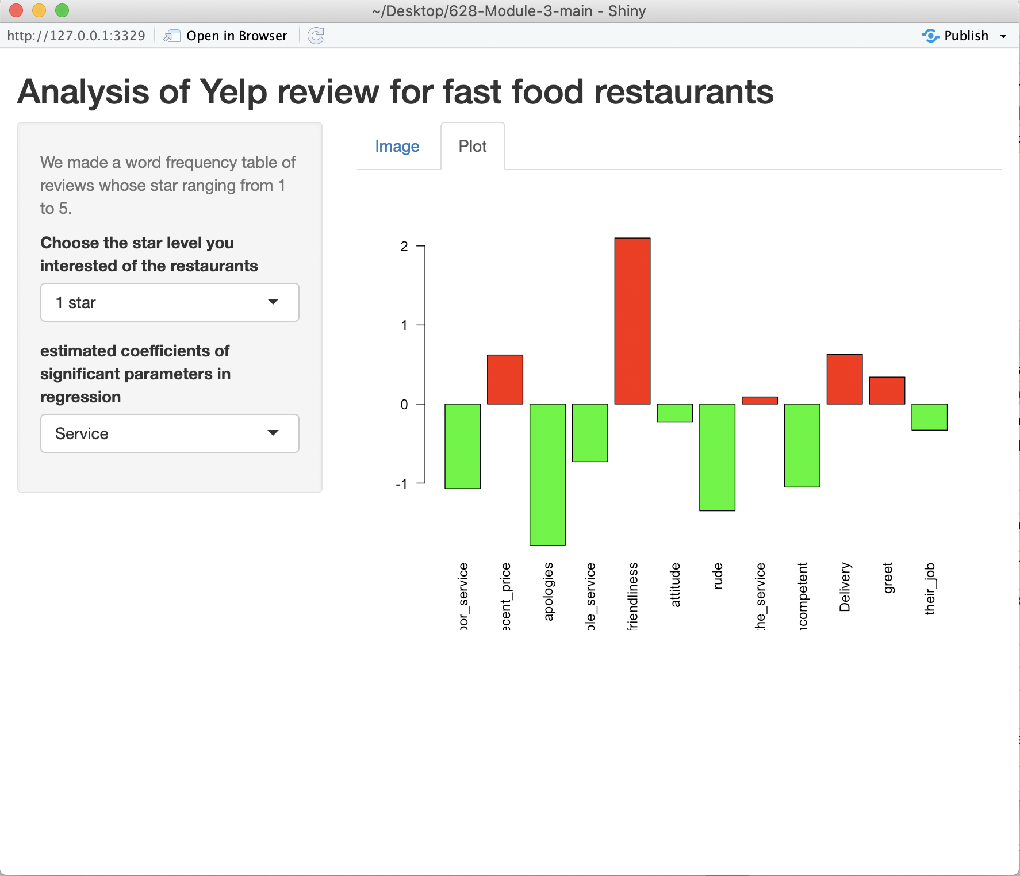

Shiny App Demonstration

